Slide 1
Introduction to Source Analysis

Slide 2
Learning intentions:
Understand key terminology used for historical source analysis
Success criteria:
Recall how key terminology is used for historical source analysis
Look at a source analysis to identify how to correctly analyse a source.

Slide 3
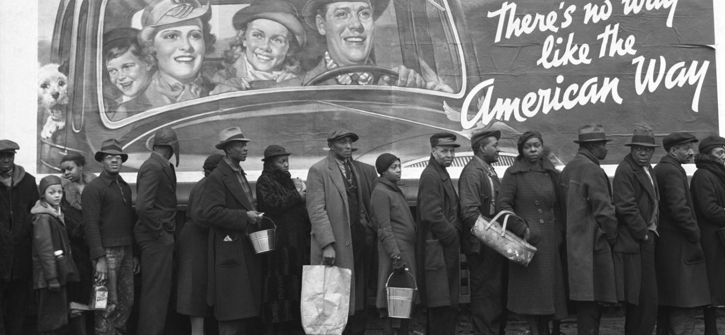
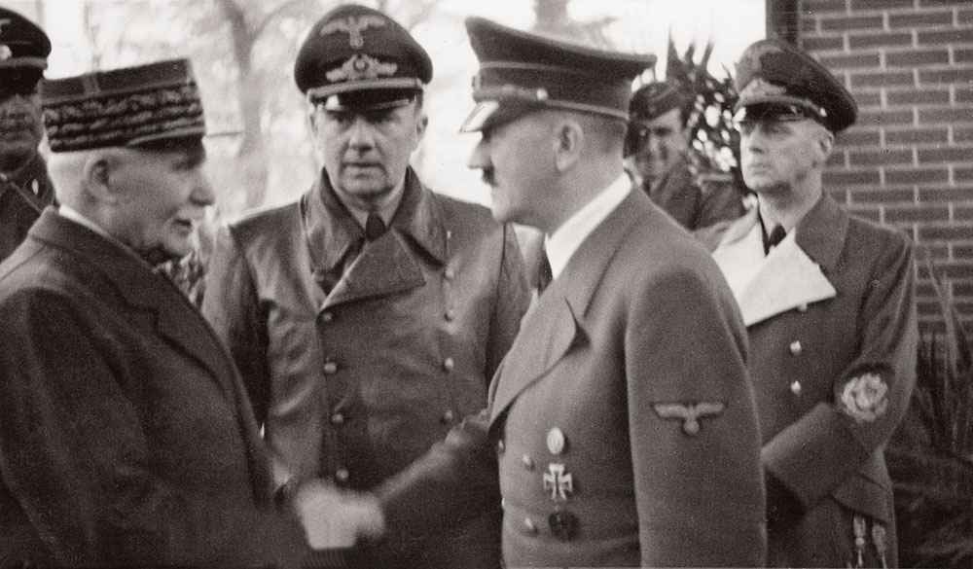
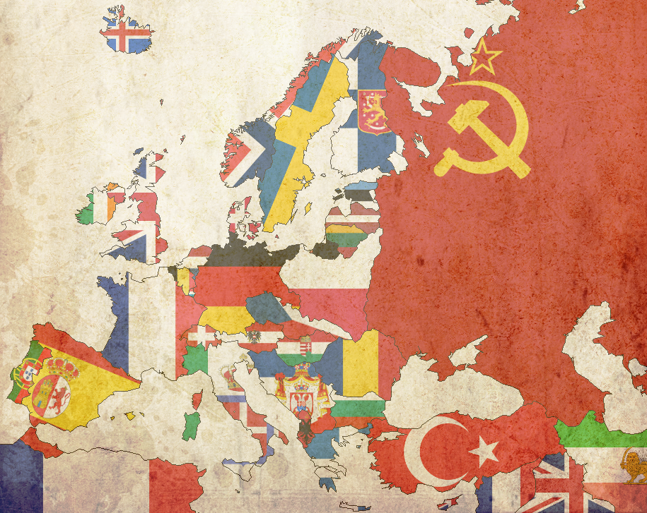
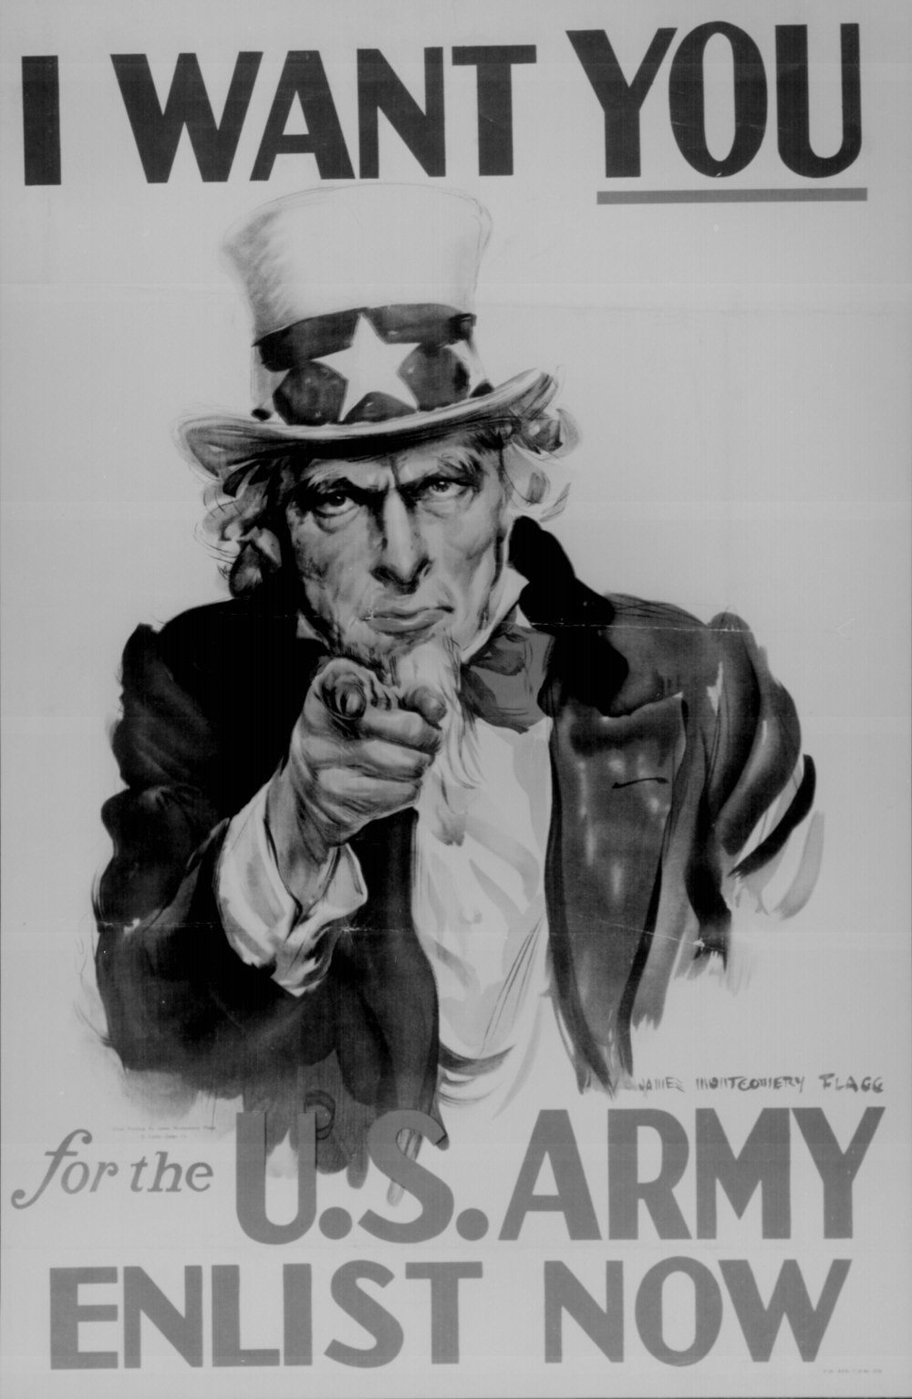
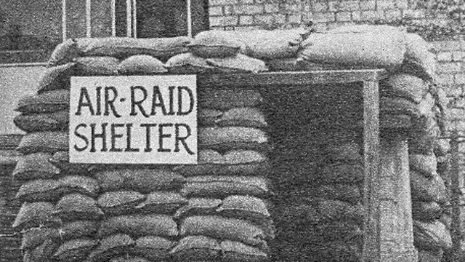
HOW DO WE KNOW ABOUT HISTORY?

Slide 4
SOURCES!

Slide 5
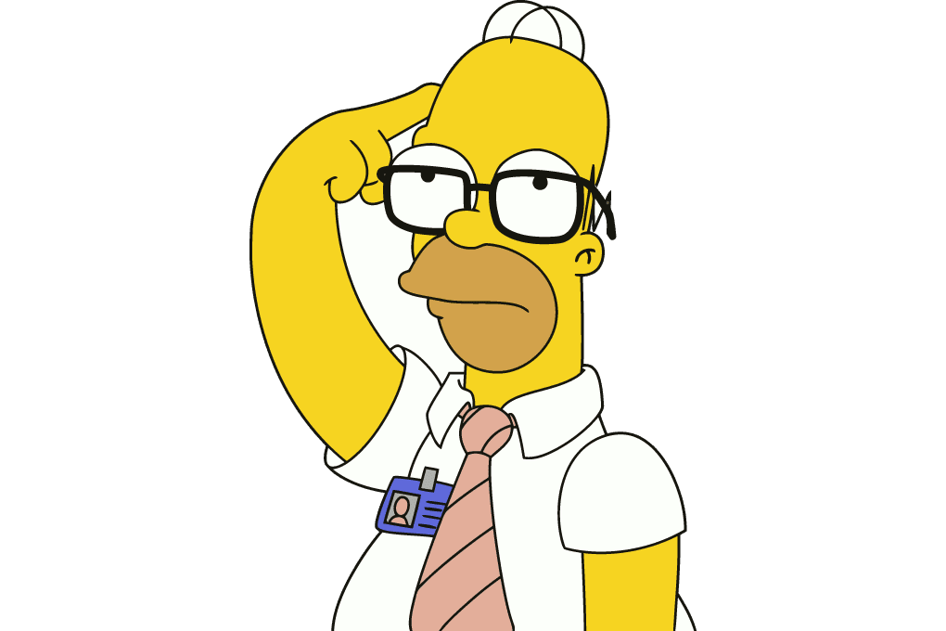
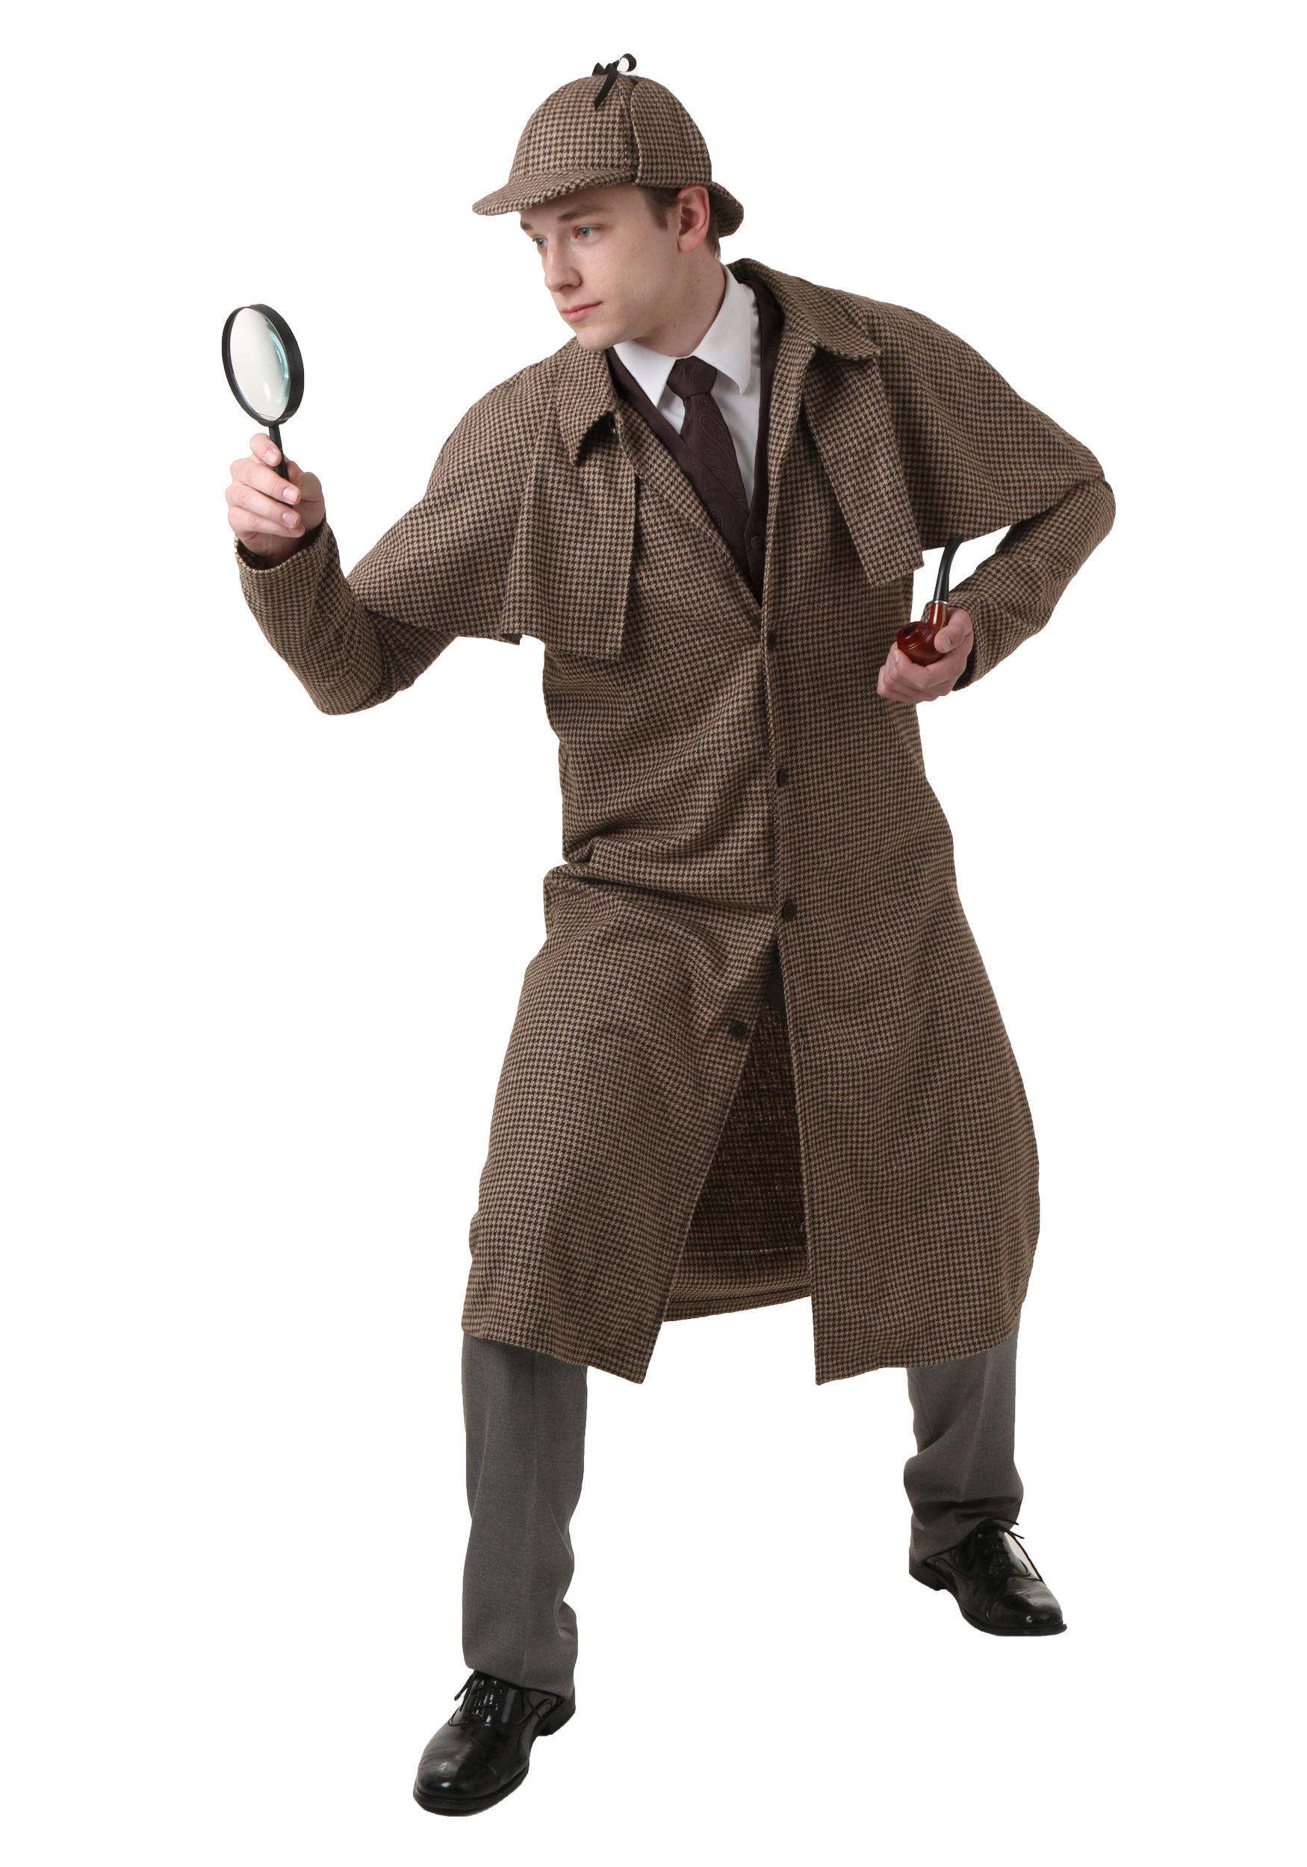
Why do we Analyse Sources?
To gather evidence to support your viewpoint or argument.

Slide 6
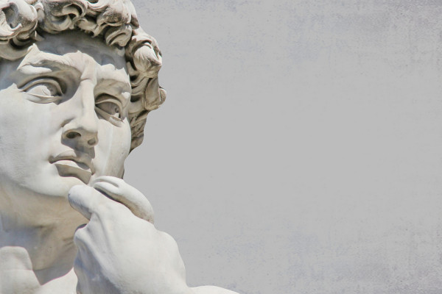
How do we analyse sources?
We ask Questions! – The more you ask, the more you will find out!

Slide 7

Message and Purpose
Message
What the creator wants you to think, feel or believe.
What is it trying to tell me?
What information can I gain from this source?
What issue/event/subject is the source referring to?
Purpose
The reason, goal or objective for creating the source.
What is this source used for?
What does its creator want you to know?
Source anal;ysis – PURPOSE
https://www.youtube.com/watch?v=uQix7Ce3sLg

Slide 8
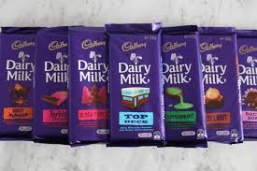
Message and Purpose: Example
Message: Eat Cadbury’s chocolate and your life will improve, it is so tasty, it can make anything better, cure boredom and keep you entertained.
Purpose: To make people buy their chocolate.

Slide 9
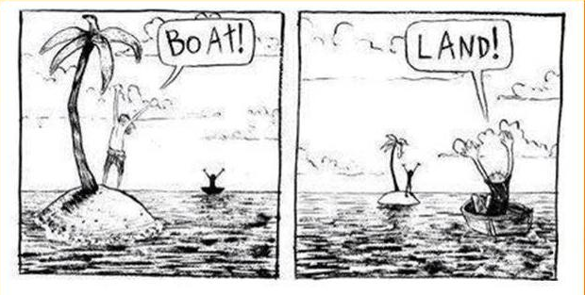
Perspective https://www.youtube.com/watch?v=BQP7sQUiYZY
The point of view of the creator.
What is the maker’s viewpoint?
Is it biased (favoring one side or only showing one part of the story)?
BIAS
https://www.youtube.com/watch?v=95FQZhtpwcs

Slide 10
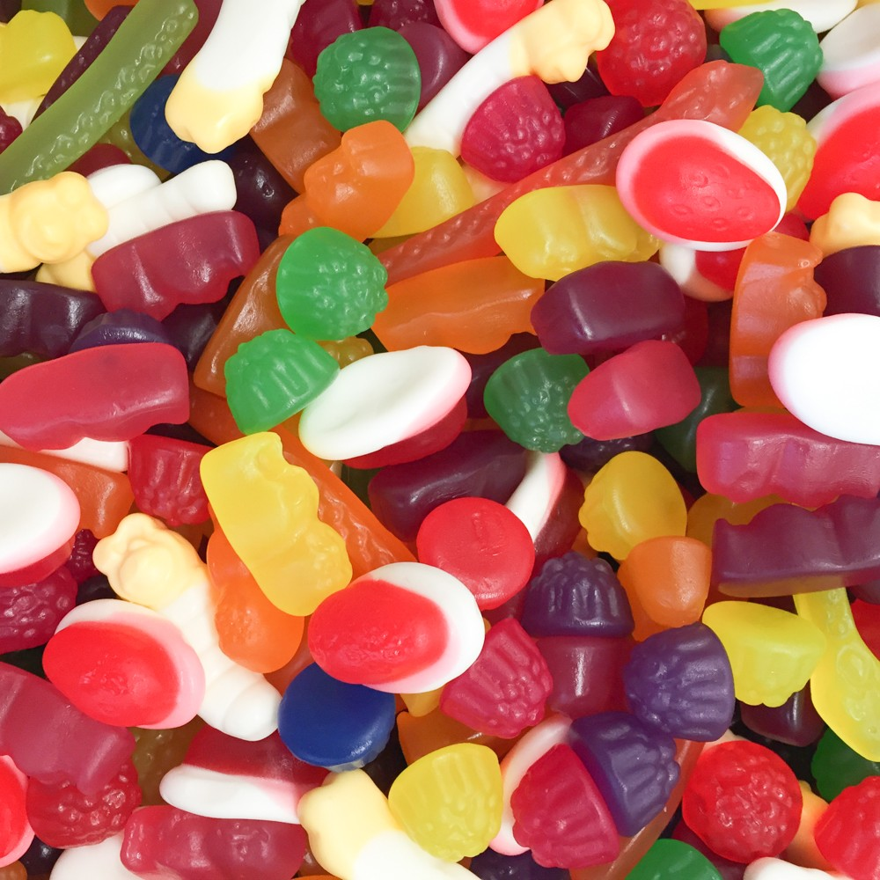
OR

Slide 11

Usefulness
https://www.youtube.com/watch?v=0OzSdQjuEfM
To decide if a source is useful you must decide if it teaches you anything!
Remember the usefulness of a source is nothing to do with it’s reliability (trustworthiness).

Slide 12

Reliability https://www.youtube.com/watch?v=IbCr1aGS4CQ
Reliability is about asking if you can trust the source.
There are different reasons why it may be trustworthy: Who – Author: Wrote or drew the source? Why – Purpose? Entertain, Public, Private? When – Were they there at the time or after? Where – Did they witness the event, are they part of the community/country or an outsider?

Slide 13
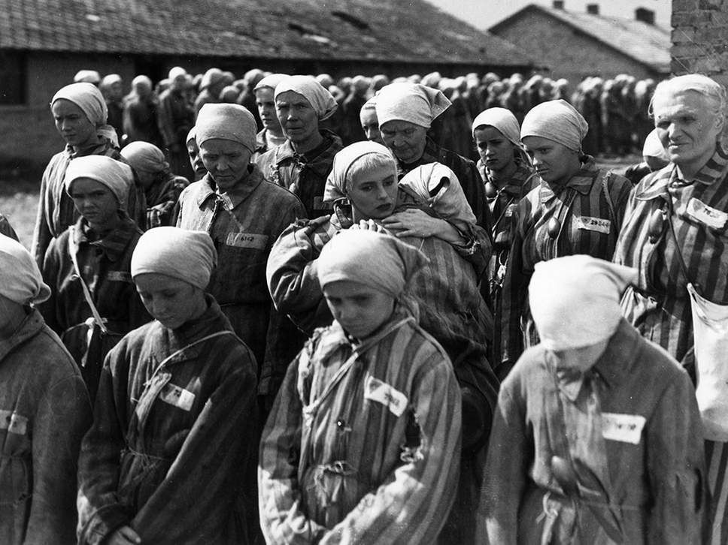
Historical Context
What was happening at the time?
Ask questions:
What
When
Cause
Effect

